Slide 1
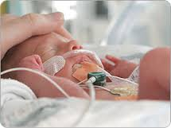
Heart Failure in infants and neonates
Dr Sanmath Shetty K
Senior Resident, Dept of Cardiology
Medical College, Calicut

Slide 2
Definition of Heart Failure
Brief review of Pathophysiology
Unique features of heart failure in neonates.
Clinical features
Fetal circulation and its changes after birth
Classification and Etiology
Management of heart failure in neonates
ISHLT guidelines 2014

Slide 3
Congestive Cardiac Failure is a clinical syndrome in which the heart is unable to pump enough blood to the body to meet its needs, to dispose off systemic or pulmonary venous return adequately, or a combination of the two.
Clinical manifestations of heart failure due to a combination of “low output state” and compensatory responses to increase it.

Slide 4
Heart failure syndromes
Acute postnatal cardiac failure: inability of heart to maintain a cardiac output necessary to maintain oxygenation of tissues. Manifest as shock or pulmonary edema.
Low cardiac output, low systemic blood flow
High cardiac output, low systemic blood flow: large AV shunts, vein of galen malformation.
Subacute or Chronic heart failure: may follow improvement from acute cardiac failure or may have an insidious onset due to progressive ventricular dysfunction.
Features: Diaphoresis, failure to thrive, weight loss, feeding difficulties, increased respiratory effort.

Slide 5
pathophysiology
Unmet tissue demands for cardiac output result in activation of
The renin-aldosterone angiotensin system
The sympathetic nervous system
Cytokine-induced inflammation
“Signaling” cascades that trigger cachexia

Slide 6
Notes:
A vicious cycle begins when decreased cardiac output
leads to increased metabolite production in downstream
organ systems. These metabolites, in turn, stimulate local
vasodilation and decreased blood pressure. Falling blood
pressure stimulates angiotensin and mineralocorticoid release
further, inducing fluid-retaining mechanisms in the
kidney and stimulating increases in systemic vascular resis-

Slide 7
Initially these compensatory effects help to improve cardiac output and maintain blood pressure.
STAGE OF “COMPENSATED SHOCK”
Long standing increases in cardiac workload and myocardial O2 consumption leads to cardiac “REMODELING”

Slide 8
Cardiac remodeling
Increase in cardiac mass ( maladaptive hypertrophy)
Expansion of myofibrillar components of individual myocytes (new cells rarely formed).
Increase in the myocyte/capillary ratio.
Activation and proliferation of nonmyocyte cardiac cells (may produce scarring).
Ultimately causes: a poorly contractile and less compliant heart

Slide 9
HF in neonates: UNIQUE FEATURES
The neonatal heart is more liable to develop HF because of the following factors:
The neonatal cardiac output.
The number of contractile units.
Preload, afterload and Frank Starling’s law
Sympathetic innervations and catecholamines.
Myocardial metabolism, Ca2+ and fetal Hb.
Hypoxemia and acidosis

Slide 10
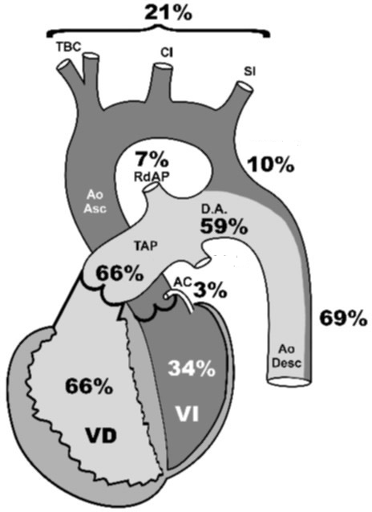
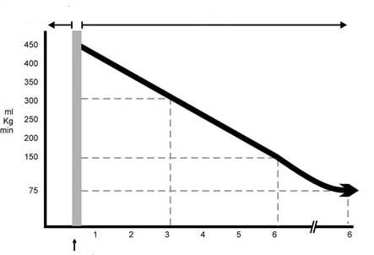
Neonatal cardiac output
Fetal life ------ combined biventricular cardiac output is 450 ml/kg/min, “parallel circulation”
RV= 300 ml/kg/min, LV= 150 ml/kg/min
Extrauterine life ------- Series circulation.
LV output= 150 450 ml/kg/min.
Cardiac output gradually reduces to adult value of 70 ml/kg/min over 6 – 12 mths.
Notes:
Cardiac outputs of 2 ventricles are different in fetuses,hence expressed as combined ventricular output

Slide 11
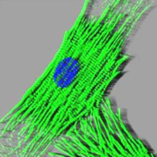
Contractile units
Neonatal heart has less contractile units per mm2 than adult hearts.
Inside the neonatal myocyte, contractile units are restricted to 30% (70% in adults)
Advantage of neonatal myocardium: ability to produce hyperplasia.

Slide 12
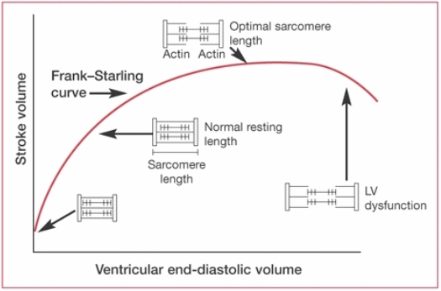
Preload, afterload, frank-starling’s law
In neonates, venous return is high because of increased cardiac output.
Frank Starling law is fully acknowledged leaving little margin for tolerating additional overload.
Afterload is directly related to radius of ventricular cavity and inversely related to wall thickness
Wall stress=pressure x radius/2 x wall thickness
In infants, radius high due to increased LVEDV and LV wall is thinner than in adults-------------- high afterload.
Notes:
Afterload is the force that resists myofibril shortening during systole ( wall stress)

Slide 13
Sympathetic innervations and catecholamines
Infants with HF:
Higher concentrations of catecholamines in circulation----- stores are depleted.
Decrease in density and number of beta receptors in myocardium.
Limits the action of exogenously administered catecholamines.

Slide 14
Myocardial metabolism, ca2+, fetal Hb
Neonatal myocyte can use only glucose 6 phosphate as fuel.
Newborn glycogen stores are limited------ hypoglycemia causes HF.
Poor sarcoplasmic reticulum in neonates---- hypocalcemia causes HF.
Fetal Hb has high affinity to oxygen. Hence , only way of increasing oxygen to tissues is by increasing cardiac output.

Slide 15
Hypoxemia and acidosis:
Frequently seen in sick newborns.
Significantly reduce cardiac contractility.

Slide 16
CLINICAL MANIFESTATIONS IN INFANTS WITH HF
Feeding abnormalities
Tachypnoea
Tachycardia
Cardiomegaly
Gallop rhythm (S3)
Hepatomegaly
Pulmonary rales
Peripheral edema
Sweating
Irritability
Failure to thrive

Slide 17
Feeding difficulties
Important clue for presence of CHF in infants
Usually first noticed by the mother
Interrupted feeding (suck-rest-suck cycles)
Inability to finish feeds, excessive time for each feed (> 30 mins)
Forehead sweating during feeds --- due to activation of sympathetic system

Slide 18
Rapid respirations
Tachypnea
> 60/min in 0-2 mth
>50/mt in 2 mth to 1 yr
>40/mt 1-5 yr in calm child
Cardiac neonatal tachypnea: due to
Increased pulmonary venous pressure (due to left to right shunt)
Pulmonary venous obstruction
Increased LVEDP.
? Neurohormonal basis
Two breathing patterns in heart disease in neonates:
Tachypnea with retractions and deep breaths: almost always seen with HF.
Tachypnea with shallow breaths: seen with reduced pulmonary flow without HF.
Happy Tachypnea: Tachypnea without significant increased work of breathing at rest, seen in infants with CHD with mild to moderate pulmonary overcirculation.

Slide 19
tachycardia
Persistently raised heart rate > 160 bpm in infants
> 100 bpm in older children.
Tachycardia in the absence of fever or crying when accompanied by rapid respirations and hepatomegaly is indicative of HF
Consider SVT if heart rate > 220 bpm in infants and > 180 bpm in older children.

Slide 20
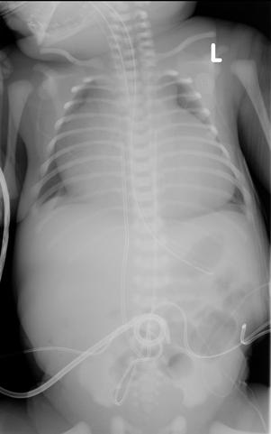
cardiomegaly
Consistent sign of impaired cardiac function, secondary to ventricular dilatation and/or hypertrophy.
Very few cases of HF do not show cardiomegaly.
rapidly fatal cardiomyopathies
supra-ventricular tachycardia in its early stages
total anomalous pulmonary venous return infra diaphragmatic type with obstruction.

Slide 21
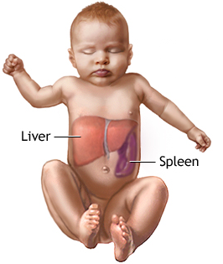
hepatomegaly
This sign is present in almost all cases of neonatal HF.
The normal neonatal liver appears large on palpation and it is found about 2 cm below the right costal edge.
In the presence of respiratory infection increased expansion of the lungs displace liver caudally.
Usually in such cases, the spleen is also palpable.

Slide 22
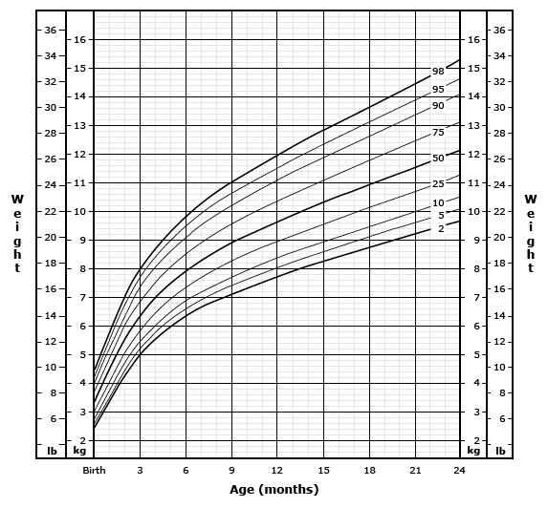
Failure to thrive
In chronic HF, there is inadequate growth
Causes: Poor feeding, frequent respiratory infections, increased metabolic requirements, decreased absorption from gut due to congestion.
Boys>girls,
Acyanotic heart disease, weight gain more affected than height.
Cyanotic heart disease, weight and height equally affected.
In acute heart failure, weight gain may be seen.
Weight gain> 30 gm/day --- suggestive of CCF
Notes:
Growth retardation more in boys compared to girls.
In cyanotic congenital heart disease, weight and height are equally affected.
In acyanotic heart disease, weight> height. Discrepancy between linear growth and weight maximum in babies with left to right shunt lesions.
Maximum growth retardation, VSD

Slide 23
Other signs of neonatal heart failure
Peripheral edema: Late sign, indicates severe heart failure, presacral and posterior chest wall edema.
Pulmonary rales: not useful, difficult to differentiate from pulmonary infections which frequently accompanies heart failure.
Pulsus alternans: seen in severe HF.
S3 or gallop rhythm: frequently seen. S3 may not indicate HF in neonates.

Slide 24
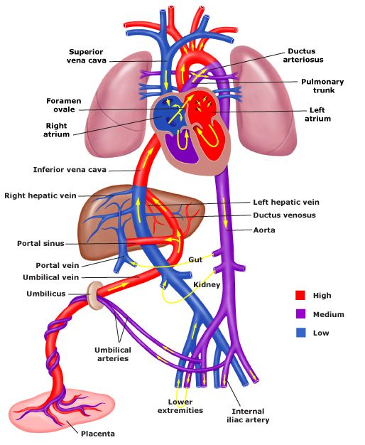
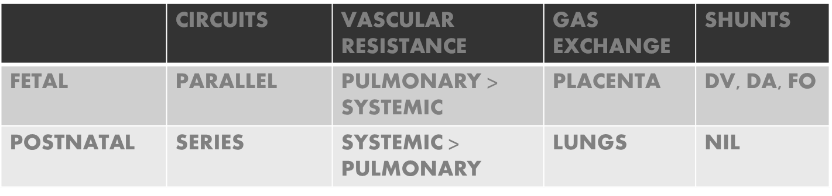
Fetal blood flow

Slide 25
Landmark events in postnatal life

Slide 26
At birth
Parallel circulation becomes series soon after birth
Lesions that present during first few days of life:
Critical AS
HLHS
Critical PS
Mitral atresia

Slide 27
Closure of the ductus arteriosus
MECHANISM
Removal of PGE2 based relaxing system
Activation of constrictor mechanism by rise in blood oxygen tension
Term infant
Preterm infant
Two phases:
Functional closure: 18 t0 24 hours after birth
Anatomic closure: over next 2 – 3 weeks
Remains open for many days following birth.
Cause:
Immature ducts have high threshold of response to oxygen.
Immature ducts are more sensitive to PGE2 and NO
PGE2 fail to get metabolized by immature lungs.

Slide 28
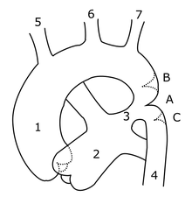
Cardiac lesions that manifest during closure of the ductus
Functional closure:
Depend for pulmonary flow (TOF with pulmonary atresia)
Depend for systemic flow (IAA/CoA)
Depend for mixing of systemic and pulmonary blood (TGA)
Anatomic closure:
CoA

Slide 29
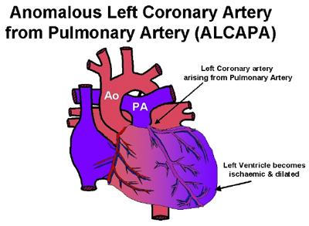
Pulmonary Vascular resistance falls further after birth between 3 to 6 weeks
Large VSD
PDA
ALCAPA
Notes:
In ALCAPA, blood flow in left coronary artery will depend on flow from collaterals from RCA once pulmonary aretery pressure falls

Slide 30
Classification
NYHA Heart Failure Classification: Not well translated for use in infants.
The Original Ross Classification
Ross Scoring system for heart failure in infants
Modified Ross score: for older children
New York University Paediatric heart failure index

Slide 31
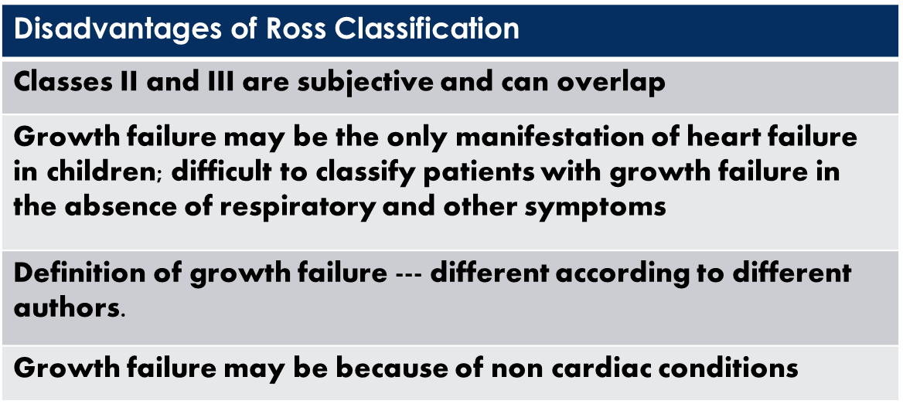
Original ross Classification
Class I :
No Limitations or symptoms
Class II:
Mild tachypnea or diaphoresis with feedings in infants
Dyspnea in older children
No growth failure
Class III:
Marked tachypnea or diaphoresis with feedings
Prolonged feeding times
Growth failure from CCF
Class IV
Symptomatic at rest with tachypnea, retractions, grunting or diaphoresis

Slide 32
Ross scoring system in infants
 | 0 | 1 | 2
FEEDING HISTORY
Volume consumed/ feed(oz) | > 3.5 | 2.5-3.5 | < 2.5
Time taken per feeding (min) | < 40 | > 40 | ----
PHYSICAL EXAMINATION
Respiratory rate (/min) | < 50 | 50-60 | > 60
Heart rate (/min) | < 160 | 160-170 | > 170
Respiratory pattern | Normal | Abnormal | ----
Peripheral perfusion | Normal | Decreased | ----
S3 or diastolic rumble | Absent | Present
Liver edge from costal margin (cm) | < 2 | 2-3 | > 3
Total score
0-2 (no CHF)
3-6 (mild CHF)
7-9 (mod CHF)
10-12 ( severe CHF)

Slide 33
New York university paediatric heart failure index– Connelly et al.
30 point scale
Failure to thrive | 2 points
Prolonged feeding time | 1 point
Retractions | 2 points
Severe Tachypnea | 2 points
Resting sinus tachycardia | 2 points
Hepatomegaly 3 cms below the costal margin | 1 point
Marked cardiomegaly | 1 point
High doses of diuretics | 2 points
Digoxin | 1 point
ACE inhibitor | 1 point
Anti arrhythmic agents | 2 points
Anticoagulants | 2 points
Abnormal function by echocardiography | 2 points
Single ventricle physiology | 2 points

Slide 34
Proposed HF staging for infants and children by the International Society for Heart and Lung Transplantation
  Modified from the American College of Cardiology/American Heart Association guidelines and complementing the Ross classification system
  Stage A: Patients with increased risk of HF but normal cardiac function and no evidence of cardiac chamber volume overload
    Examples: previous exposure to cardiotoxic agents, family history of heritable cardiomyopathy, congenitally corrected transposition of the great arteries
  Stage B: Patients with abnormal cardiac morphology or cardiac function, with no symptoms of HF, past or present
  Examples: history of anthracycline with LV dysfunction, Aortic insufficiency with LV dysfunction.
  Stage C: Patients with underlying structural or functional heart diseases and past or current symptoms of HF
  Stage D: Patients with end-stage HF requiring continuous infusion of inotropic agents, mechanical circulatory support, cardiac transplantation, or hospice care

Slide 35
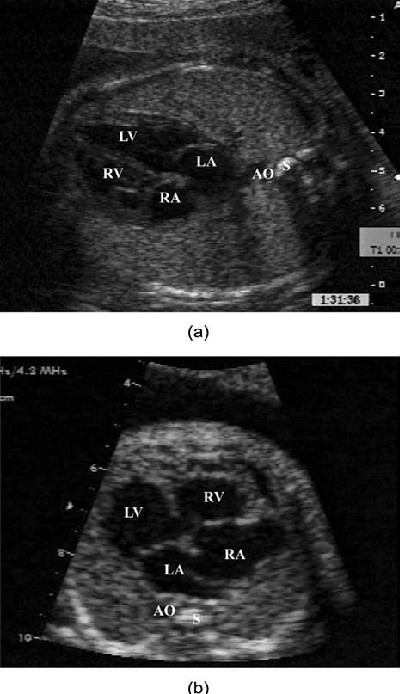
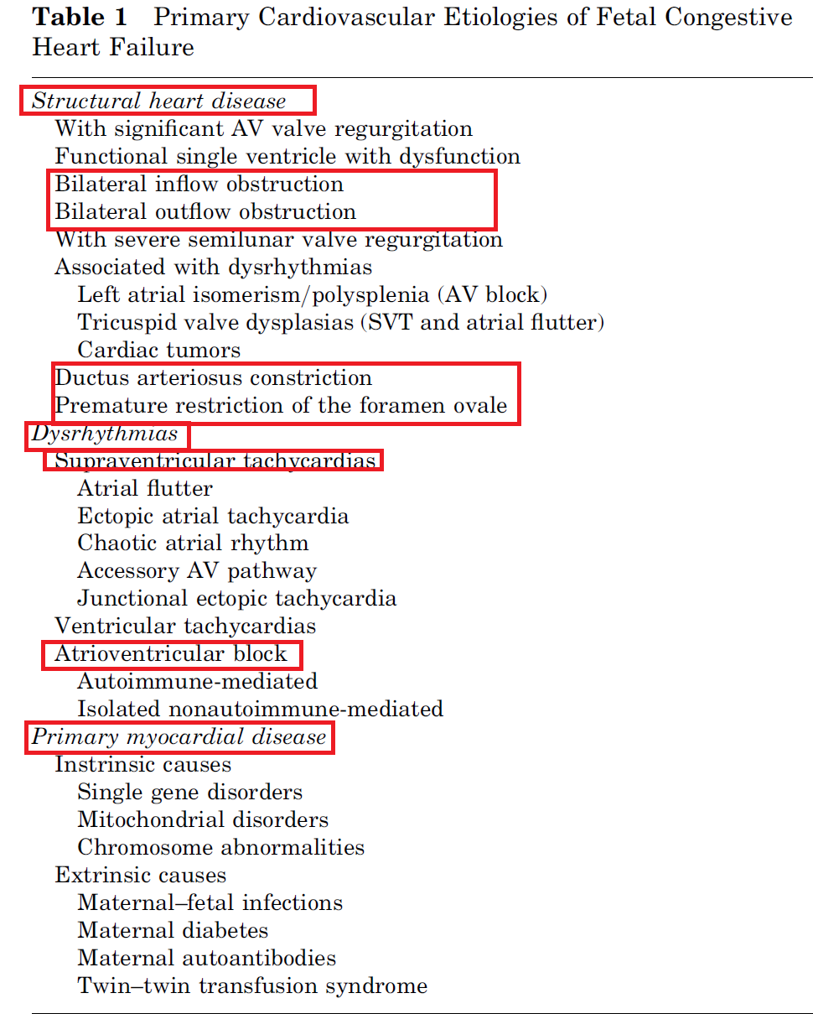
Heart failure in the fetus
CHF in utero is manifested as right heart failure– pericardial or pleural effusions, ascites and peripheral (skin,placental) edema.
Fetal Hydrops: nonspecific term, two or more fluid collection in the fetus.
Fetal heart failure causes 26-40% of nonimmune hydrops.
Echo: Cardiomegaly.
Cardiothoracic area > 0.3
Cardiothoracic circumference > 0.5
Systolic dysfunction: Fractional shortening (N=28-40%)
Diastolic dysfunction: small or absent E wave

Slide 36
NEONATAL HEART FAILURE
Etiology- cardiac causes

Slide 37
Etiology- non cardiac causes
Metabolic abnormalities- Severe hypoxia, acidosis, hypoglycemia, hypocalcemia
Endocrinopathies: Hyperthyroidism
Severe Anemia: Hydrops fetalis
Bronchopulmonary dysplasia
Sepsis
Arteriovenous fistula, vein of galen malformation

Slide 38
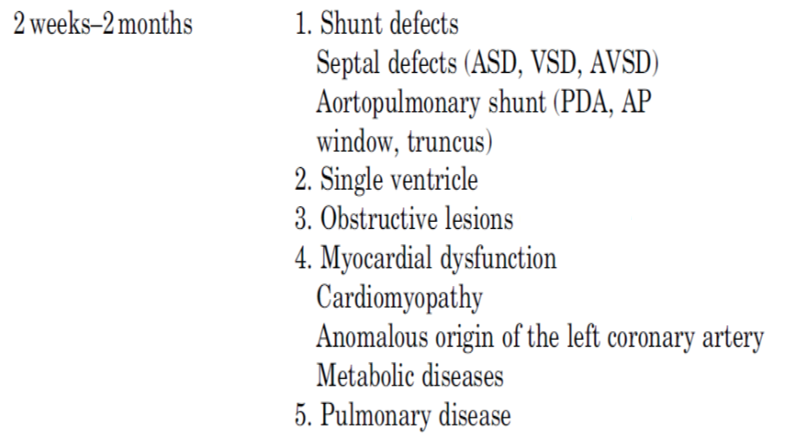
Etiology of Neonatal Heart Failure by Age of presentation

Slide 39
Investigations
Blood tests: CBC, creatinine. Glucose, Calcium
Pulse oximetry
ECG
ABG
Radiological tests: CXR
Echo
Biomarkers
Cardiac catheterization: in patients with heart failure following repair or palliation of congenital heart disease ( residual disease, assessment of shunt function)

Slide 40
Hyperoxia test
Administer 100 % oxygen for > 10 min
PaO2 > 100 mmHg: pulmonary disease likely
PaO2 < 70 mmHg, rise by < 30 mmHg or SaO2 unchanged: cardiac cause (R-L shunt) likely
Exceptions:
Total anomalous pulmonary venous return may respond
Pulmonary disease with a massive intrapulmonary shunt may not respond

Slide 41
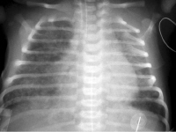
CXR
Cardiomegaly: Absence rules out CHF (exception: obstructed TAPVC)
Upper limit 0.55 in infants and 0.6 in neonates.
Thymic shadow may mimic mediastinal widening in infants.
Features of pulmonary venous hypertension:
Stage | PCWP | Radiologic appearance
Stage 1 | 13-17 mm Hg | Pulmonary veins upper lobe > lower lobe “Cephalization” or ‘staghorn’ or ‘ inverted moustache’ appearance
Stage 2 | 18-25 mm Hg | Interstitial edema– perihilar haziness, peribronchial cuffing, Kerley B lines
Stage 3 | > 25 mm Hg | Bat’s wing appearance- frank pulmonary edema
Stage 4 | Chronic pulmonary hypertension | Hemosiderosis and ossification

Slide 42
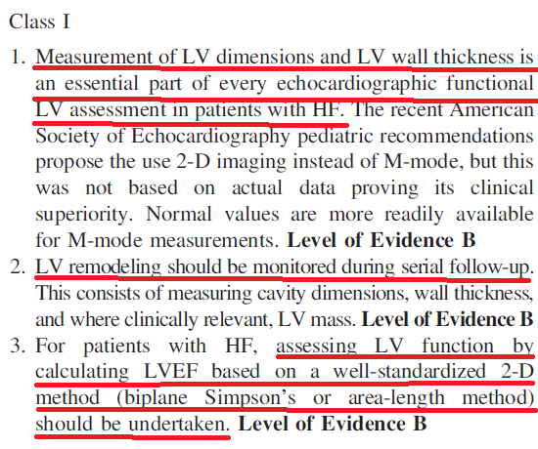
Echocardiography
Essential for identifying
Causes of HF such as structural heart disease
Ventricular dysfunction (both systolic and diastolic)
Chamber dimensions
Effusions (both pericardial and pleural)

Slide 43
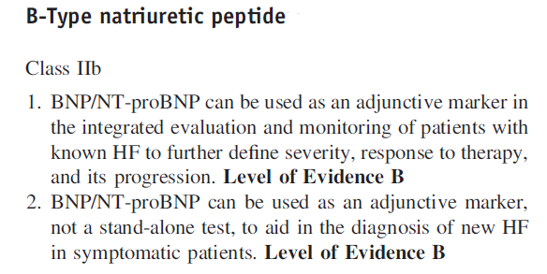
HF Biomarkers
ANP (atrial strain)
BNP (ventricular strain)
Troponins (cardiomyocyte compromise)
BNP and NT pro BNP levels rise at birth in normal healthy infants, level off at 3-4 days and then fall steadily.
Normal values for these biomarkers in infants has not been adequately established.

Slide 44
Management approach based on physiologic considerations
General circulatory models
Series Circulation
Left to right shunt Circulation
Right to left shunt Circulation
Parallel Circulation
Venous Obstruction
Ventricular Dysfunction

Slide 45
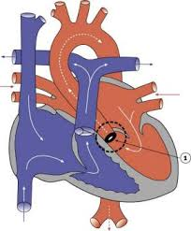
Series circulation
Normal circulatory pattern
Absence of mixing between oxygenated and deoxygenated blood
Eg:Structural malformations causing obstruction to blood flow (AS,PS)
Hypoxia : due to V/Q mismatch
Treatment:
Improve pulmonary status using diuretics, supplemental O2 and positive pressure ventilation
Inotropic support in cases of pump dysfunction.

Slide 46
Left to right shunt circulation
Characterised by a certain volume of oxygenated blood that recirculates between the lungs and the heart never making it to the systemic circulation.
Eg: ASD,VSD,PDA
Volume depends on : size of shunt, SVR and PVR, presence and degree of outflow tract obstruction
Hypoxemia: Pump Failure, LRTIs
Treatment:
Adequate oxygenation
Diuretics.
Maintaining adequate cardiac pump function with inotropes

Slide 47
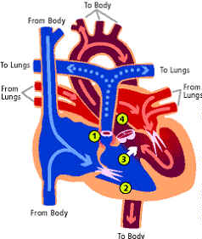
Right to left shunt circulation
Characterised by the presence of deoxygenated blood which circulates between the heart and the body without passing through the pulmonary circulation.
Volume depends on shunt size, SVR and PVR , the degree of obstruction to pulmonary circulation and the presence, absence and status of pulmonary arteries.
Hypoxemia: Due to reduced Pulmonary blood flow.
Treatment:
In severe hypoxemia and low Qp: PGE1 therapy (change to left to right shunt, oxygenation at the expense of systemic circulation)
In elevated Qp: Diuretics.
Notes:
Neonates with right to left physiology and unobstructed flow to lungs as the PVR decreases, pulmonary overcirculation and left to right shunt will predominate and cyanosis may not be evident.

Slide 48
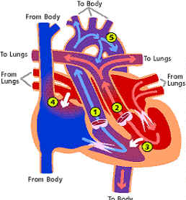
Parallel circulation
Blood recirculates through the pulmonary circuit, never providing oxygenated blood to the body, and another pool circulates through the body, never providing deoxygenated blood to the lungs.
Not compatible with life unless there is some volume of pulmonary blood that enters the systemic circulation.
Eg: TGA, DORV with malpositioned great vessels, single ventricle physiology.
Hypoxemia: postnatally due to closure of PDA and Foramen ovale.
At birth- shunts are bidirectional (Qs is maintained)
As PVR reduces, Qp>Qs, however saturation paradoxically worsens despite pulmonary overcirculation.
Treatment:
No role for oxygenation.
Shunts across atrial septum- provide palliation.

Slide 49
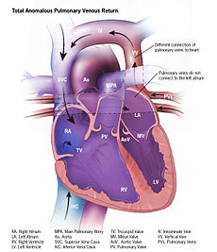
Venous obstruction
In neonates with TAPVC or single ventricle physiology due to tricuspid atresia, cardiac output and oxygenation is dependent on right to left shunting at atrial level.
In such conditions, obstruction to pulmonary or systemic venous return reduces cardiac output.
Treatment:
Maintenance of preload to maintain right to left shunt.
CVP monitoring, judicious use of fluids and diuretics.
Inotropes with chronotropic effect avoided- shortens diastolic filling time.

Slide 50
Ventricular dysfunction
Both systolic and diastolic dysfunction seen in neonates.
Eg: ALCAPA: ischemic cardiomyopathy
Treatment:
Reducing preload (diuretics) and afterload (ACE inhibitors/ ARBs) conditions.
Inotropic support

Slide 51
TREATMENT--general measures
Bed rest and limit activities
Nurse propped up or in sitting position
Control fever
Expressed breast milk for small infants
Fluid restriction in volume overloaded
Optimal sedation
Correction of anemia ,acidosis, hypoglycemia and hypocalcaemia if present

Slide 52
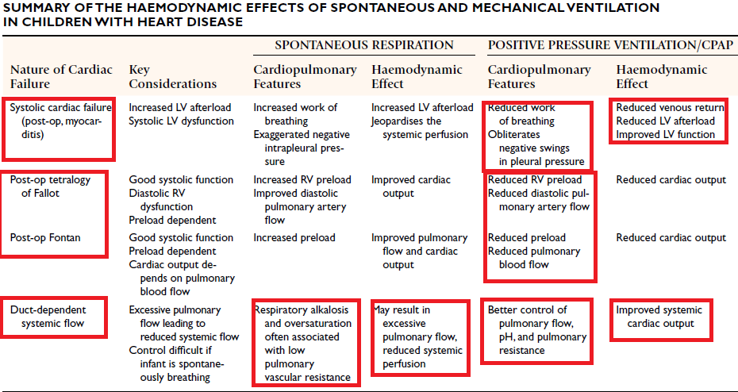
Ventilation- cardiopulmonary interactions
Non invasive ventilation ( Mask, CPAP)
Invasive ventilation
Positive pressure ventilation:
Reduces work of breathing
Reduces filling of right side of the heart
Reduces left ventricular transmural pressure (reduced afterload)

Slide 53
Nutritional support
Goals:
Provide sufficient calories and proteins to allow normal growth and prevent breakdown of lean body mass.
To make up for the past deficiencies and allow “catch-up” growth.
Approx 150 kcal/kg/day
Increase calorie density of feeds due to restricted fluid intake
Babies on diuretics: supplementation of electrolytes (Na, K, Cl)

Slide 54
Drug therapy
Three major classes of drugs:
Diuretics
Inotropic agents
Afterload reducing agents

Slide 55
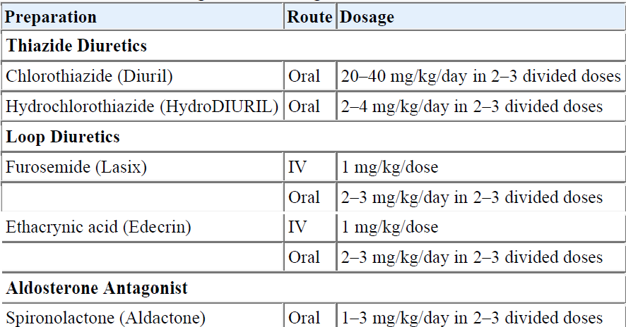
diuretics
Prinicipal therapeutic agent to reduce pulmonary and systemic congestion.
Side effects: Hypokalemia (except spironolactone), hypochloremic alkalosis

Slide 56
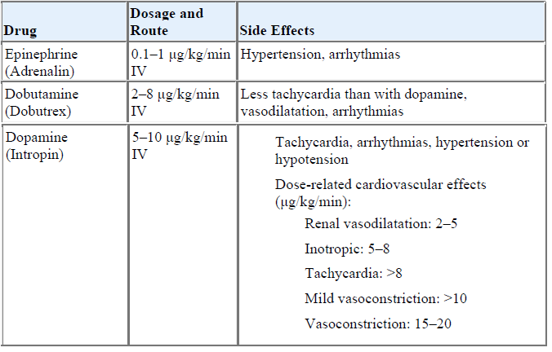
Rapid acting inotropic agents
Useful in critically ill infants with hypotension, those with renal dysfunction and postoperative patients in HF.
Milrinone: noncatecholamine agent, PDE inhibitor, inotropic + vasodilator effect.

Slide 57
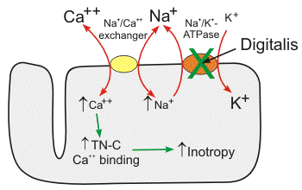
digitalis
Inotropic action
Parasympathomimetic action (slows heart rate and AV conduction)
Mild diuretic action.
Decreases myocardial oxygen consumption in failing heart.
Uses:
DCM to increase CO
CHF from L to R shunts: after diuretic and afterload reducing agent, if further improvement is needed
Therapeutic range: 0.8-2 ng/ml

Slide 58
Digitalization
1.) Baseline ECG and serum electrolytes
2.)Calculate the oral total digitalizing dose
Maintenance dose is 25% of the total dig.dose.
I.V. dose is 75% of the oral dose.
3.) Give one half of the TDD immediately ,then 1/4th & then the final 1/4th at 6- to 8-hr intervals.
4.) Start the maintenance dose 12 hrs after the final TDD
Age | Total digitalizing dose(μg/kg) | Maintenance dose(μg/kg/D)
Prematures | 20 | 5
Newborns | 30 | 8
< 2yrs | 40-50 | 10-12
> 2yrs | 30-40 | 8-10

Slide 59
Afterload reducing agents
Augments the stroke volume without a great change in contractile state, i.e, without increasing myocardial oxygen demand.
DRUGS
Arteriolar vasodilator Hydralazine
Venodilators Nitroglycerin
Mixed Vasodilators ACE inhibitotrs (captopril, enalapril) Nitroprusside Prazosin
Notes:
Vasoconstriction secondary to reduced cardiac output is deleterious to the failing heart.

Slide 60
Beta blockers
Small scale studies have shown benefit of using beta blockers in some children with chronic CHF who were symptomatic after being treated with standard drugs (digoxin, diuretics and ACEI) .
Should not be used in decompensated heart failure.
Starting dose:
Metoprolol: 0.1-0.2 mg/kg per dose twice daily.
Carvedilol: 0.09 mg/kg per dose twice daily.

Slide 61
carnitine
Cofactor for transport of long chain fatty acids into mitochondria for oxidation.
Improved myocardial function and reduced cardiomegaly in patients with DCM.
Dosage: 50-100 mg/kg/day twice to thrice daily (max 3 g)

Slide 62


Slide 63
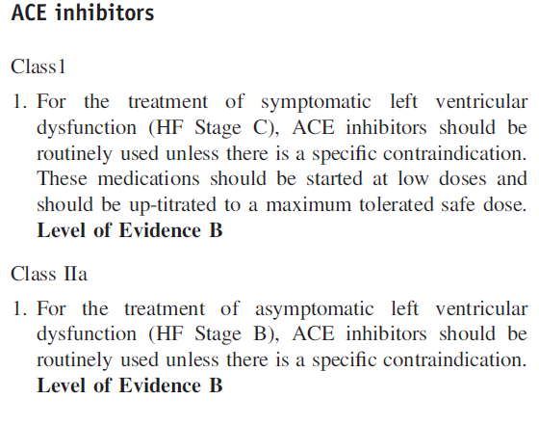
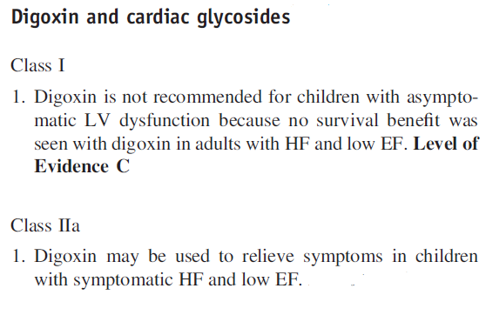
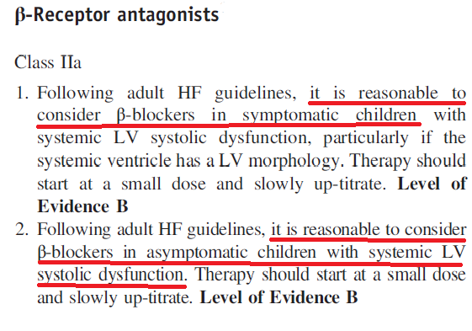
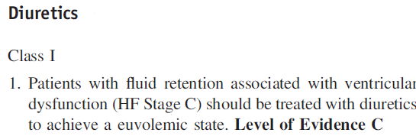
Pharmacologic management of chronic reduced ef heart failure
Drug | Symptomatic HF | Asymptomatic HF
Diuretics | Recommended | Not recommended
ACE inhibitors | Recommended | May be used
Digoxin | May be used | Not recommended
Beta blockers | May be used | May be used

Slide 64
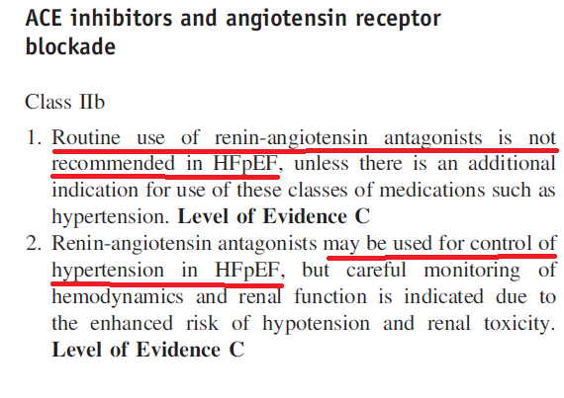
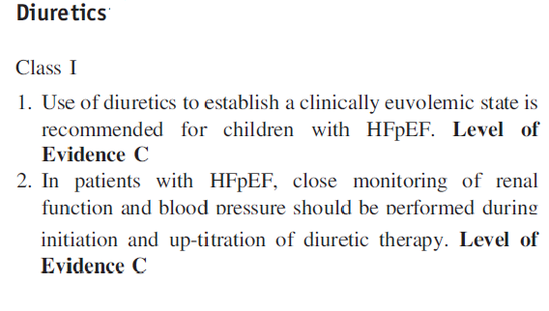
Pharmacologic management of “preserved Ef” failure

Slide 65
Surgical treatment
Pacemaker and implantable defibrillator therapy
Biventricular pacing
Ventricular assist devices
Cardiac Transplantation

Slide 66
REFERENCES:
1.) Paediatric Heart Failure. Robert E Shaddy, Gil Wernovsky: Chapters 6, 7, 14, 15, 16; Taylor and Francis group, 2005.
2.) Heart Failure in congenital heart disease; from fetus to adult. Robert E Shaddy: Chapter 2; Springer, 2011.
3.) Park’s paediatric cardiology for practitioners. Myung K Park, 6th edition: Chapter 27; Saunders, 2014.
4.) Madriago E, Silberbach M, Heart failure in infants and children: Paediatrics in review , 2010; 31; 4-12.
5.) Hsu TD, Pearson GD. Heart Failure in Children: Part I: History, Etiology, and Pathophysiology. Circ Heart Fail. 2009;2:63-70.
6.) Hsu TD, Pearson GD. Heart Failure in Children: Part II: Diagnosis, Treatment, and Future Directions. Circ Heart Fail. 2009;2:490-498.
7.) Sharma M, Nair MNG, Jatana SK, Shahi BN. Congestive Heart Failure in Infants and Children: MJAFI 2003; 59 : 228-233
8.) Anderson’s Paediatric cardiology, 3rd edition, chapter 14.

Slide 67
thank you

